Slide 1

GPIO Interrupt pin circuit
Pullup resistor
MCU

Slide 2
GPIO Interrupt pin setting
GPIO pin mode : Input
  GPIO_SetMode(PB, BIT12, GPIO_MODE_INPUT);
GPIO pin chip internal Pull-up
  GPIO_ENABLE_PULL_UP(PB, BIT12);
GPIO interrupt trigger type : RISING/FALLING/BOTH_EDGE/HIGH/LOW
  GPIO_EnableInt(PB, BIT12, GPIO_INT_FALLING);
GPIO Interrupts : two groups = ABC or DEF
  NVIC_EnableIRQ(GPABC_IRQn); // ABC group share 1 interrupt to CPU
  NVIC_EnableIRQ(GPDEF_IRQn); // DEF group share 1 interrupt to CPU
GPIO pin debouncing
  Debounce Clock Source = LIRC (10KHz) or HCLK
  GPIO_SET_DEBOUNCE_TIME(GPIO_DBCLKSRC_LIRC, GPIO_DBCLKSEL_64);
  GPIO_ENABLE_DEBOUNCE(PB, BIT12);

Slide 3
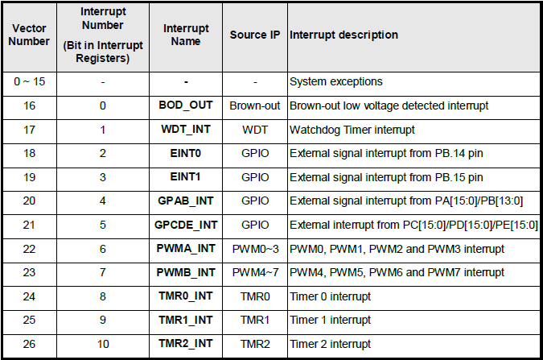
External Interrupt Pins (INT0 & INT1)
Two Pins dedicated for External Interrupt (higher interrupt priority then GPIO interrupt)

Slide 4
GPIO_EXTINT
void Init_EXTINT(void)
{
// Configure EINT0 pin and enable interrupt by falling edge trigger
GPIO_SetMode(PB, BIT14, GPIO_MODE_INPUT);
GPIO_EnableEINT0(PB, 14, GPIO_INT_FALLING);
NVIC_EnableIRQ(EINT0_IRQn);
// Configure EINT1 pin and enable interrupt by rising and falling edge trigger
GPIO_SetMode(PB, BIT15, GPIO_MODE_INPUT);
GPIO_EnableEINT1(PB, 15, GPIO_INT_RISING); // RISING, FALLING, BOTH_EDGE, HIGH, LOW
NVIC_EnableIRQ(EINT1_IRQn);
// Enable interrupt de-bounce function and select de-bounce sampling cycle time
GPIO_SET_DEBOUNCE_TIME(GPIO_DBCLKSRC_LIRC, GPIO_DBCLKSEL_64);
GPIO_ENABLE_DEBOUNCE(PB, BIT14);
GPIO_ENABLE_DEBOUNCE(PB, BIT15);
}

Slide 5
GPIO_EXTINT
int32_t main()
{
SYS_Init();
Init_EXTINT();
while(1);
}
Note: Open Debug Session to run in Keil MDK to see printf message !

Slide 6
GPIO_EXTINT
void EINT0_IRQHandler(void)
{
GPIO_CLR_INT_FLAG(PB, BIT14); // Clear GPIO interrupt flag
printf("PB14 EINT0 occurred.\n");
}
void EINT1_IRQHandler(void)
{
GPIO_CLR_INT_FLAG(PB, BIT15); // Clear GPIO interrupt flag
printf("PB15 EINT1 occurred.\n");
}

Slide 7
Timer Features
Four 24-bit up-counting timer
A prescaler (divider) for each Timer
Selectable 5 clock source
  Four modes : one shot, periodic, toggle, continuous
Timeout Period calculation
  Time out period =
  (Period of timer clock source)
  *(8-bit Prescale + 1)
  * (24-bit TCMP)

Slide 8
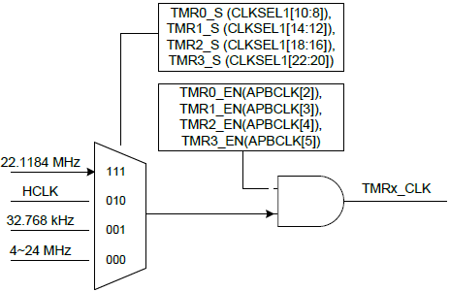
Timer Clock Source
NUC140

Slide 9
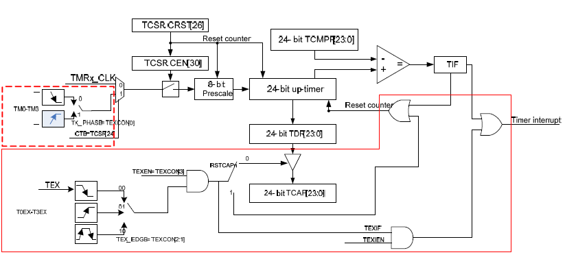
NUC140 Timer Block Diagram

Slide 10
Timer operation modes
Example: TCMPR = 100
One-Shot mode
Periodic mode / Toggle mode
Continuous Counting mode
Interrupt
0
One shot
100
Reset counter
Periodic
0
100
Overflow
0
100
Continuous
101
2²⁴-1

Slide 11
TIMER & GPIO INTERRUPT
ScanKey() & Display_7seg(i)
int main(void)
{
uint16_t i;
SYS_Init();
OpenSevenSegment();
OpenKeyPad();
while(1)
{
i = ScanKey(); → GPIO INTERRUPT
Display_7seg(i); → TIMER
}
}

Slide 12
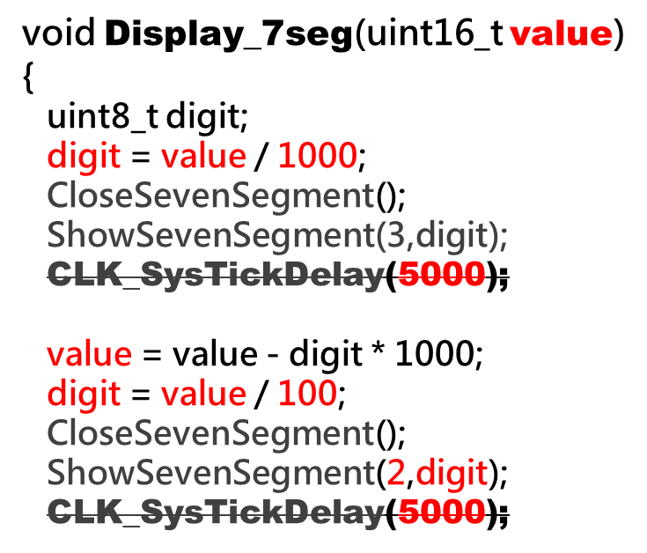
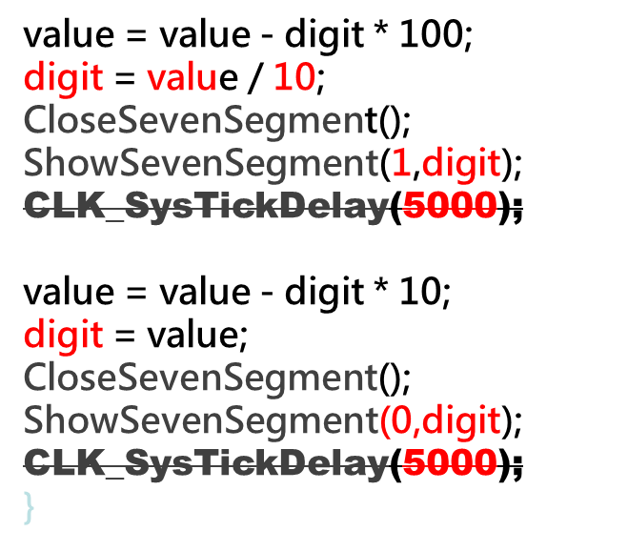
Display_7seg(i) (OLD)

Slide 13
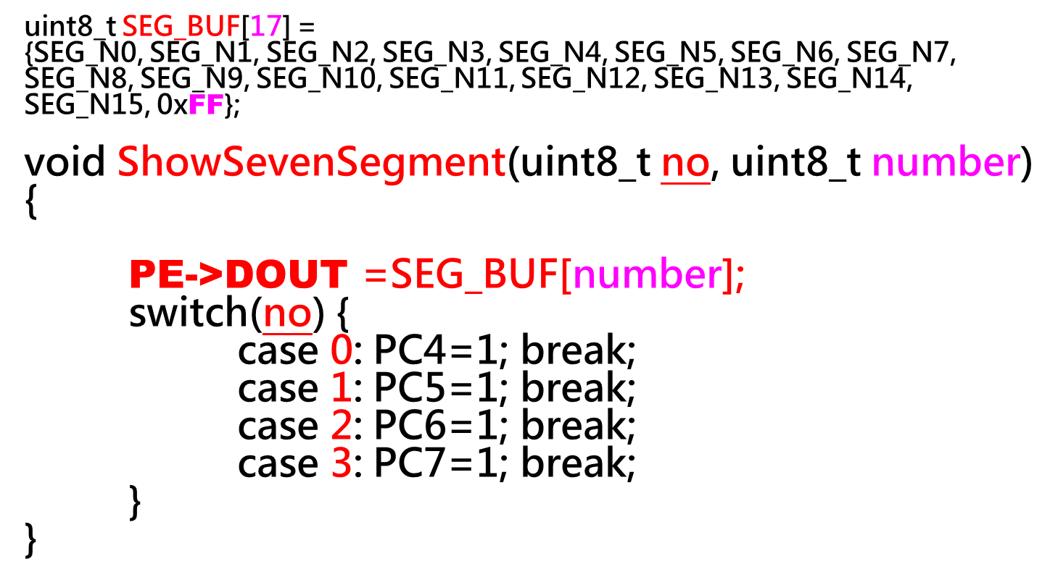
ShowSevenSegmen

Slide 14
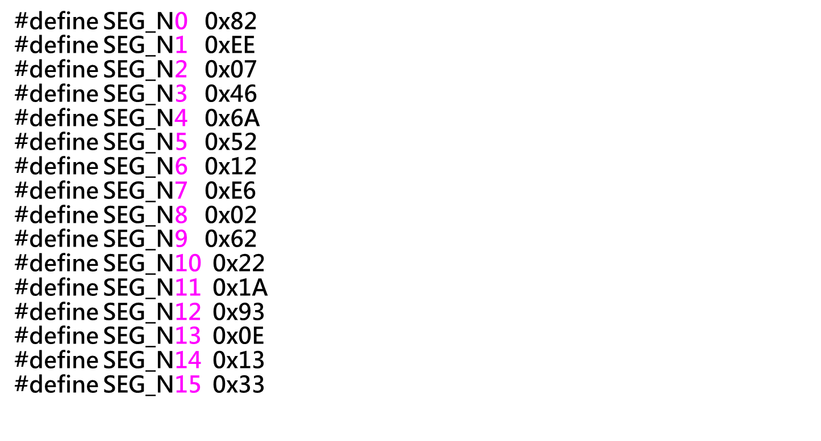
SEG_BUF[17]

Slide 15
TIMER PERIODIC, 200Hz = 5ms =5000us
void Init_Timer1(void)
{
TIMER_Open(TIMER1, TIMER_PERIODIC_MODE, 200);
TIMER_EnableInt(TIMER1);
NVIC_EnableIRQ(TMR1_IRQn);
TIMER_Start(TIMER1);
}

Slide 16
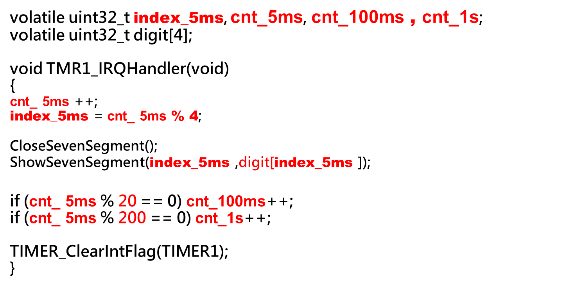
TMR1_IRQHandler

Slide 17
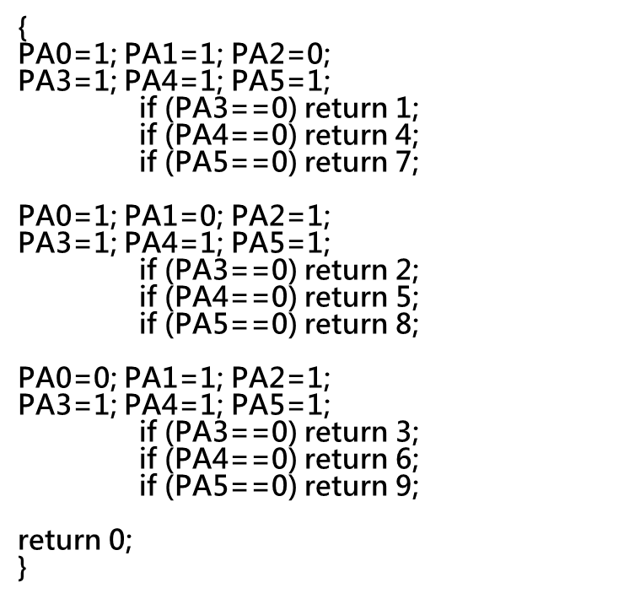
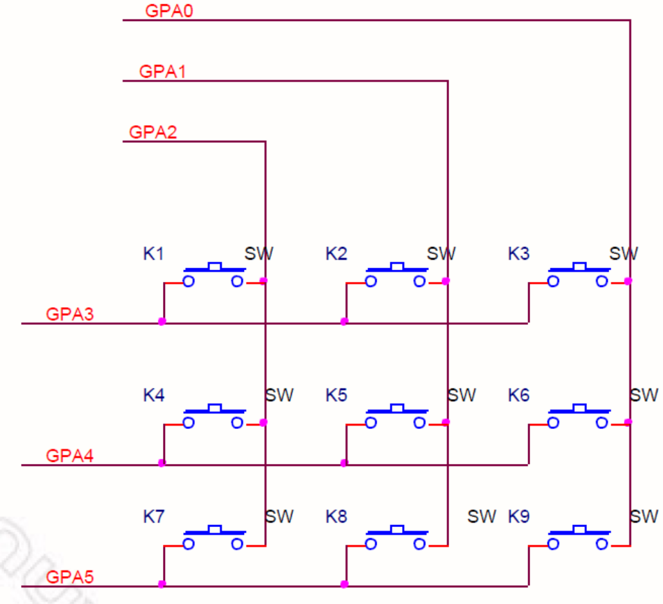
uint8_t ScanKey(void)

Slide 18
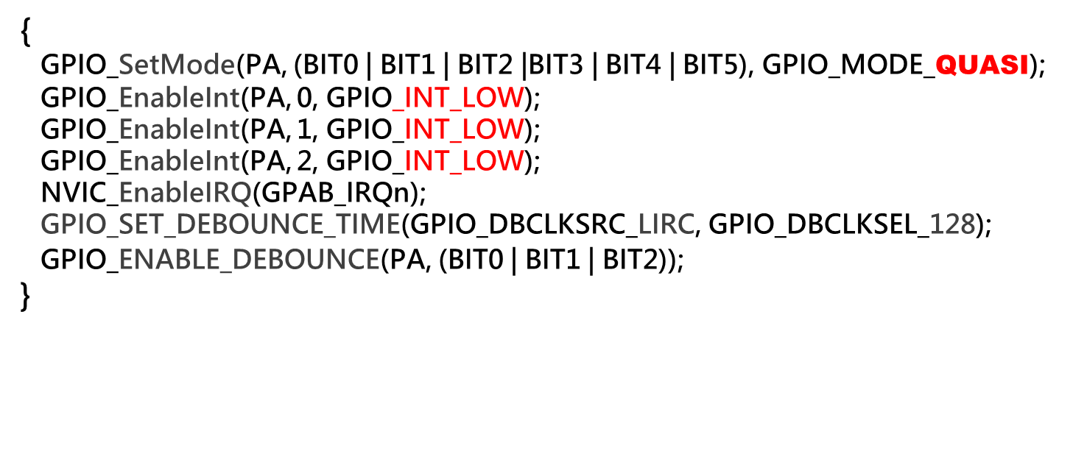
void Init_KEY(void)

Slide 19
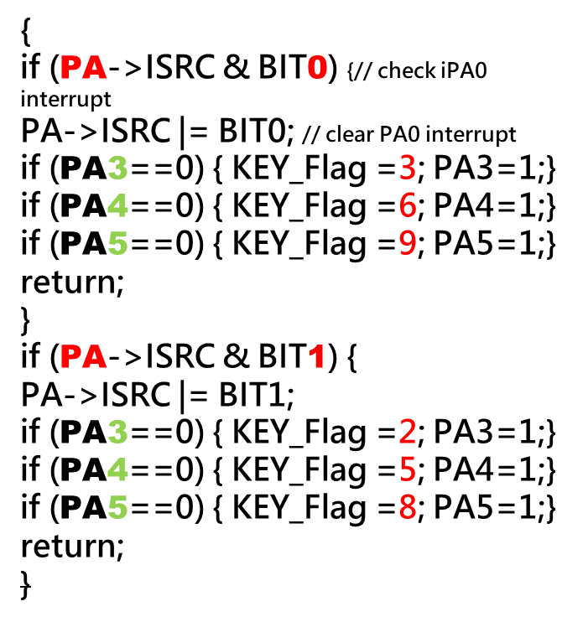
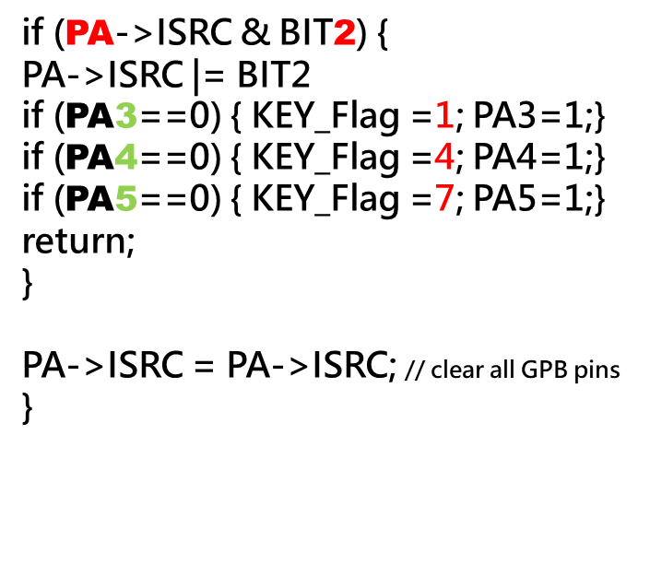
void GPAB_IRQHandler(void)

Slide 20
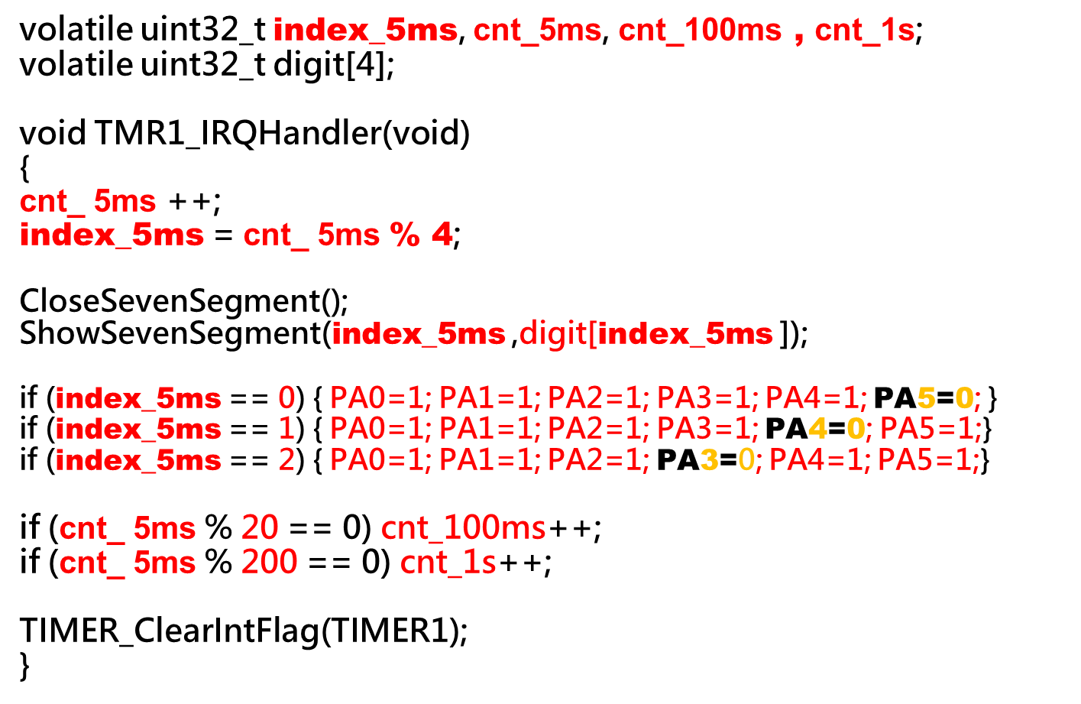
void TMR1_IRQHandler(void)

Slide 21
int main(void)
SYS_Init
Init_Timer1();
Init_KEY();
OpenSevenSegment();
index_5ms=cnt_5ms=0;
cnt_1s=cnt_100ms=0;
digit3 = 16; KEY_Flag = 0;
while(1) {
if (KEY_Flag !=0) {
digit[3] = KEY_Flag;
KEY_Flag =0;
}
digit[2] = (cnt_100ms %1000) / 100;
digit[1] = (cnt_100ms %100) / 10;
digit[0] = cnt_100ms %10;
}

Slide 22
WatchDog Timer
18-bit up counter
8 selections of time out period
Support function:
  WDT interrupt
  WDT reset
  WDT wakeup

Slide 23
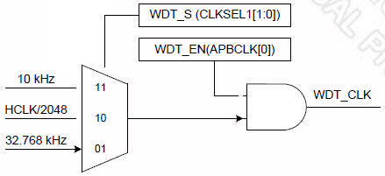
WDT Clock Source
LIRC
LXT

Slide 24
MCU_init.h
//Define Clock source
#define MCU_CLOCK_SOURCE
#define MCU_CLOCK_SOURCE_HXT // HXT, LXT, HIRC, LIRC
#define MCU_CLOCK_SOURCE_LXT
#define MCU_CLOCK_FREQUENCY 32000000 //Hz
//Define MCU Interfaces
#define MCU_INTERFACE_WDT

Slide 25
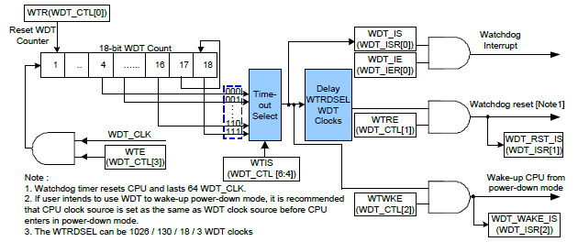
WDT block diagram

Slide 26
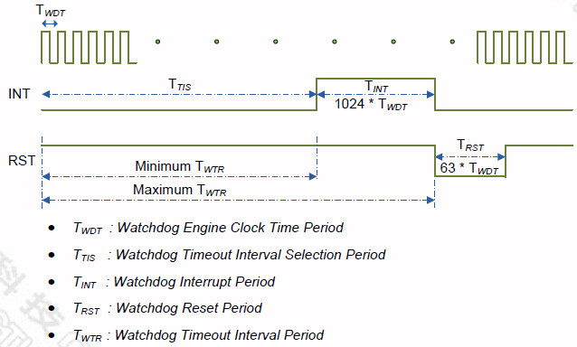
WDT Interrupt & Reset timing diagram

Slide 27
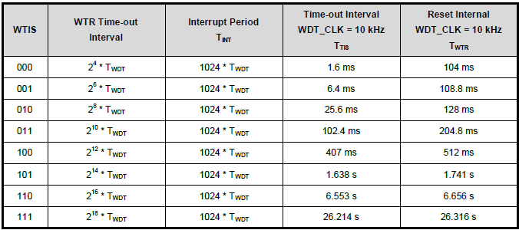
WDT Time-out
Time-out
Interrupt
10KHz = 0.1ms
2^n x0.1ms
1024x0.1ms
=102.4ms

Slide 28
WDT Time-out
12MHz
32KHz
WTIS | Interrupt Timeout | Watchdog Reset Timeout | WTR Timeout Interval for Reset (WDT_CLK=12MHz) | WTR Timeout Interval for Reset (WDT_CLK=32KHz)
000 | 2⁴ WDT_CLK (16 WDT_CLK) | (2⁴ + 1024) WDT_CLK (1040 WDT_CLK) | 86.67us | 32.5 ms
001 | 2⁶ WDT_CLK | (2⁶ + 1024) WDT_CLK | 90.67 us | 34 ms
010 | 2⁸ WDT_CLK | (2⁸ + 1024) WDT_CLK | 106.67 us | 40 ms
011 | 2¹⁰ WDT_CLK | (2¹⁰ + 1024) WDT_CLK | 170.67 us | 64 ms
100 | 2¹² WDT_CLK | (2¹² + 1024) WDT_CLK | 426.67 us | 160 ms
101 | 2¹⁴ WDT_CLK | (2¹⁴ + 1024) WDT_CLK | 1.45 ms | 544 ms
110 | 2¹⁶ WDT_CLK | (2¹⁶ + 1024) WDT_CLK | 5.55 ms | 2080 ms
111 | 2¹⁸ WDT_CLK | (2¹⁸ + 1024) WDT_CLK | 21.93 ms | 8224 ms

Slide 29
Real Time Clock
Real Time Clock (RTC) controller provides user the real time and calendar message. The clock source of RTC is from an external 32.768 kHz low speed crystal connected at pins X32I and X32O (Refer to to pin Description) or from an external 32.768 kHz low speed oscillator output fed at pin X32I.

Slide 30
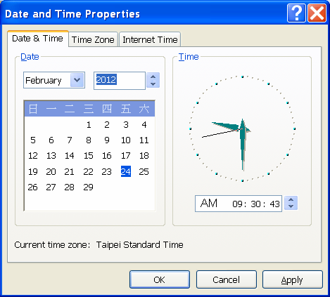

RTC Features
RTC counter
  Time counter
  Calendar counter
  Day of week
  Leap year
  BCD format
    TLR=0x00093043
    CLR=0x00120229
A set of Alarm
Alarm and time tick interrupt
Wakeup function
32KHz compensation

Slide 31
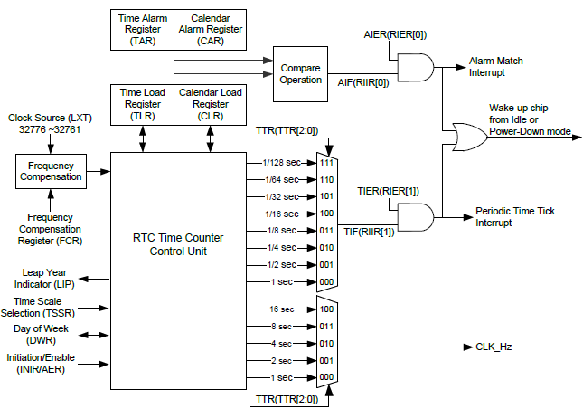
RTC block diagram

